Slide 1


Jetpack Compose: Future of Android UI
Bhavna Thacker
Freelance Android Developer
Youtuber, Learn Android Development
India

Slide 2
Agenda
What is Jetpack Compose?
Why use Jetpack Compose?
How to build UI Components? - Demo
How to Apply Material Theme to UI? - Demo
How to build lists?

Slide 3
What is Jetpack Compose?

Slide 4

Jetpack Compose
Android’s Modern Toolkit for building Native UI
Built using Kotlin
UI Development Faster and Easier
FOCUS ON FEATURES!
Source: Android Developers Blog

Slide 5
Why use Jetpack Compose?

Slide 6
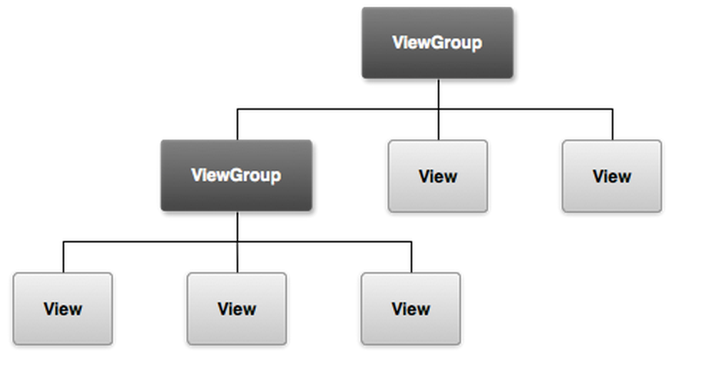
Android UI Toolkit
Over 10 years old
View.java - over 30,000 lines of code
HARD TO MAINTAIN!
Source: Stack Overflow

Slide 7
Android UI Toolkit
Jetpack Compose
MainActivity.kt
activity_main.xml
MainActivity.kt
MainScreen.kt
Multiple Languages
Single Language
Tight Coupling
Loose Coupling

Slide 8
Android UI Toolkit
Jetpack Compose
setContentView(R.layout.activity_main)
setContent {
MainScreen(“2021”)
}

Slide 9
(
)
f
DATA
UI

Slide 10

Source: Pixabay.com

Slide 11
Horizontal Linear Layout
@Composable function
Row {
Image(.......)
Text(.......)
}
ImageView
TextView

Slide 12
Vertical Linear Layout
@Composable function
ImageView
Column {
Image(.......)
Text(.......)
Button(.......)
}
TextView
Button

Slide 13
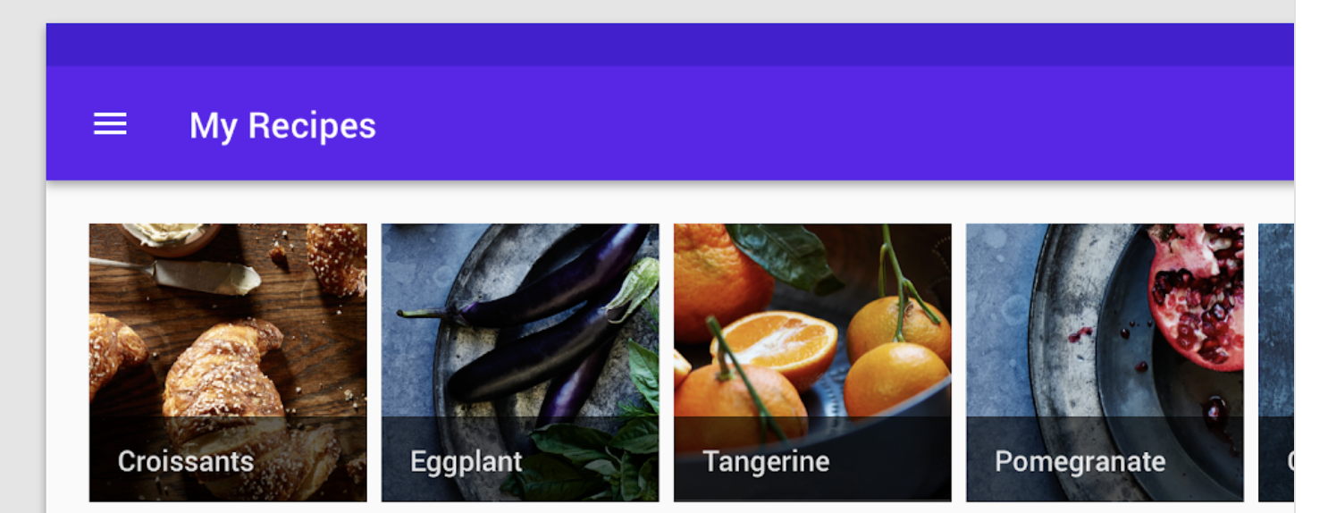
RecyclerView (Horizontal)
LazyRow
@composable
fun MyRecipes(recipes: List<Recipe>) {
LazyRow {
items(recipes) { recipe ->
recipeCard(recipe)
}
}
}
Source: Material.io

Slide 14
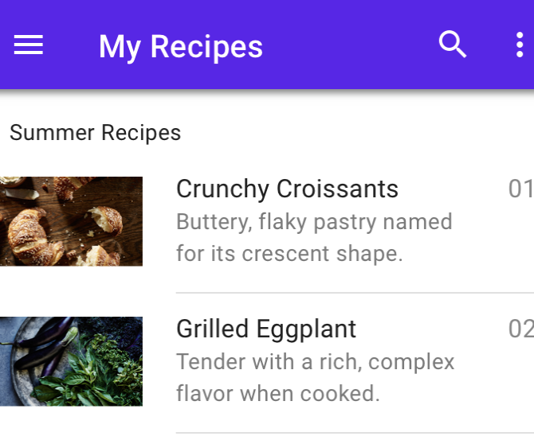
RecyclerView (Vertical)
LazyColumn
@composable
fun MyRecipes(recipes: List<Recipe>) {
LazyColumn {
items(recipes) { recipe ->
recipeCard(recipe)
}
}
}
Source: Material.io

Slide 15
What to learn next?
Using state in Jetpack Compose
Jetpack Compose Theming
Jetpack Compose Animation
Testing in Jetpack compose
Navigating screens in Jetpack Compose
Reference: https://developer.android.com/jetpack/compose

Slide 16
Thank You!
Bhavna Thacker
Freelance Android Developer
Youtuber, Learn Android Development
India

